Slide 1
WHY PL/SQL
Disadvantages of SQL
1) SQL does not have Procedural Capabilities
Conditional Checking, Looping and Branching
2)SQL Statements are passed to Oracle Engine one at a time
- Decreases the speed of data processing
3)SQL has No facility to handle user defined error.

Slide 2
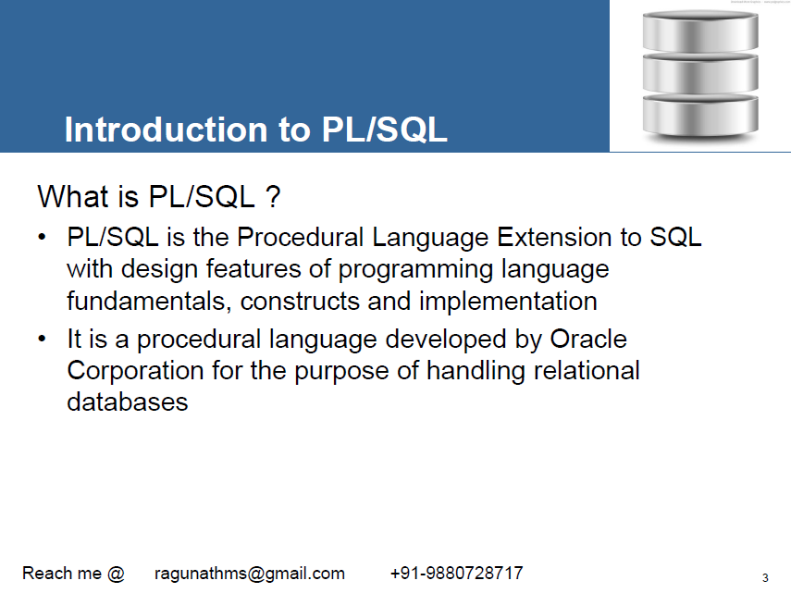

Slide 3
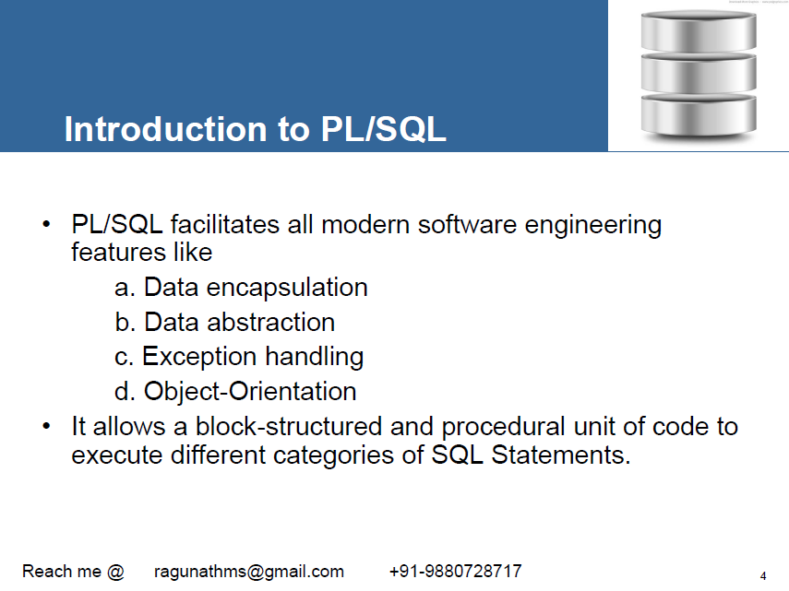

Slide 4
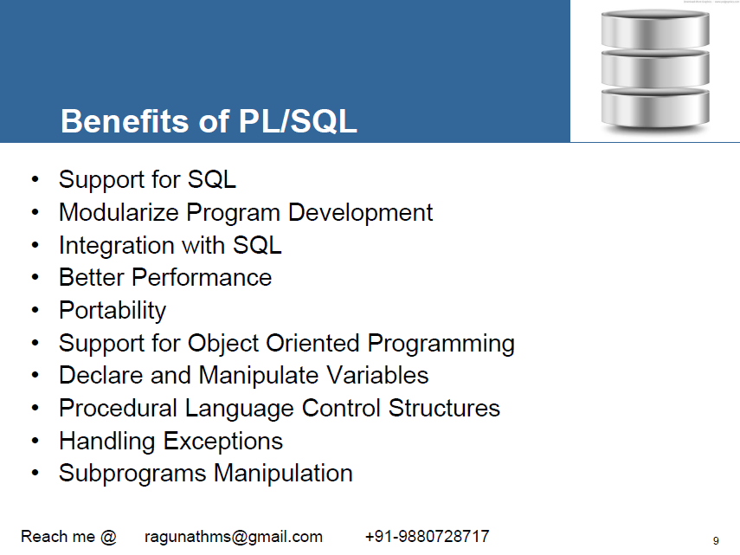

Slide 5
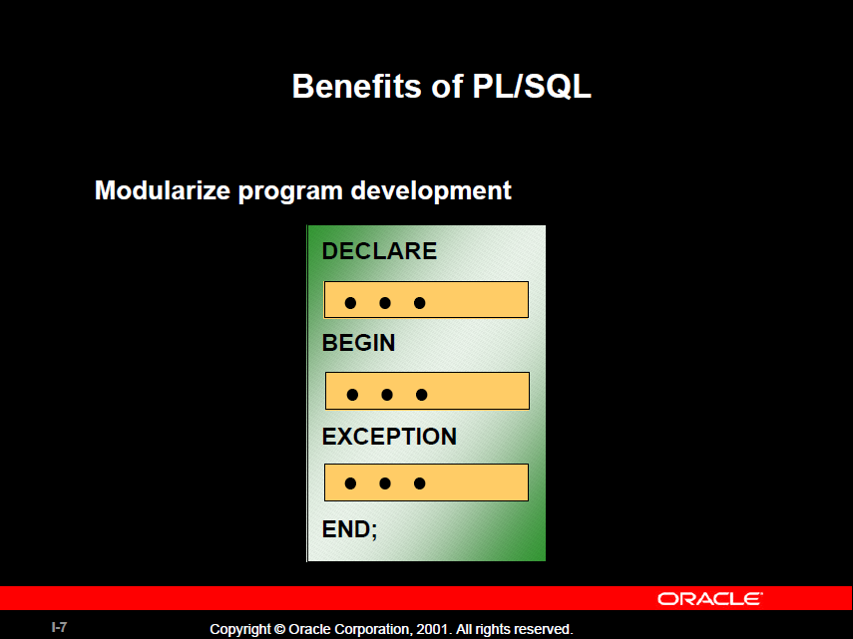

Slide 6
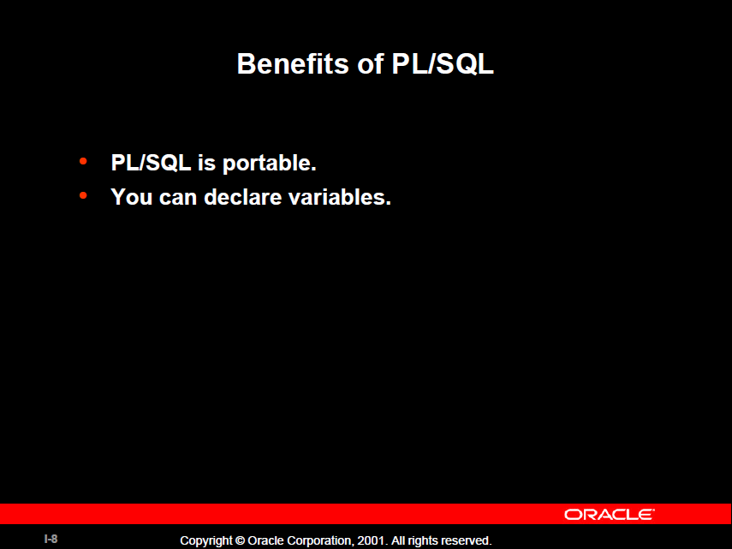

Slide 7
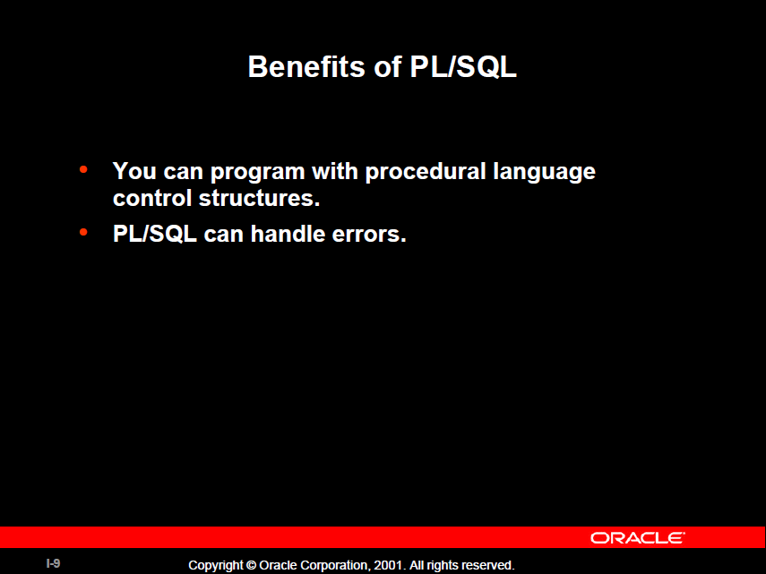

Slide 8
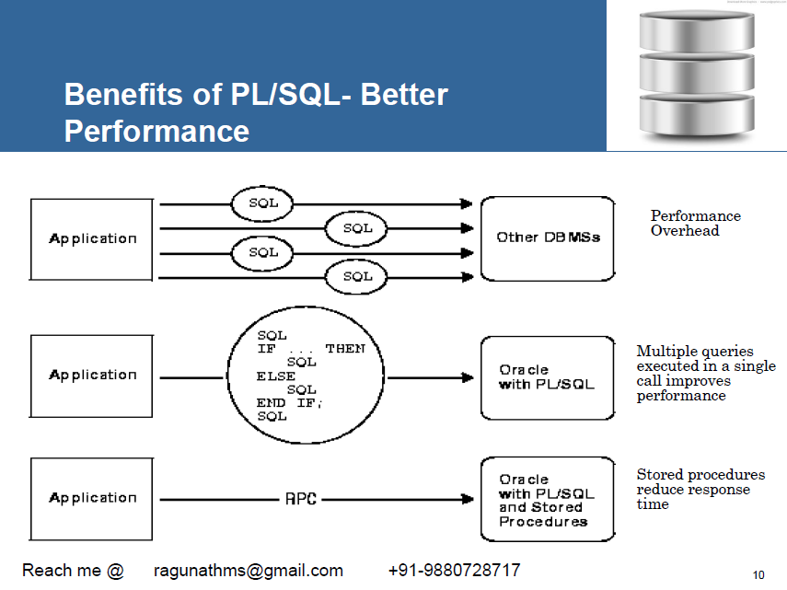

Slide 9
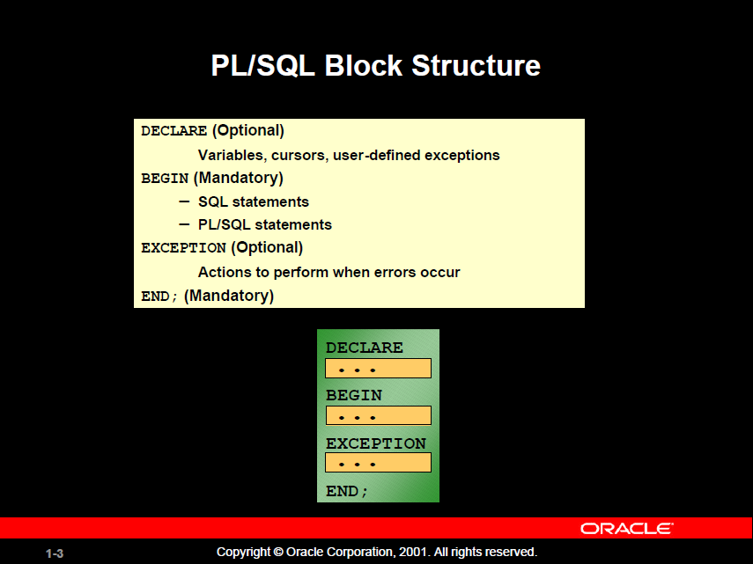

Slide 10
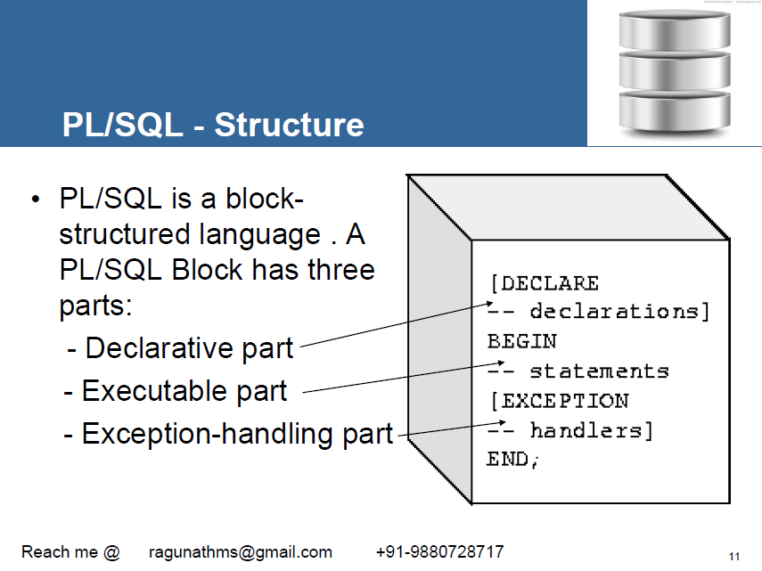

Slide 11
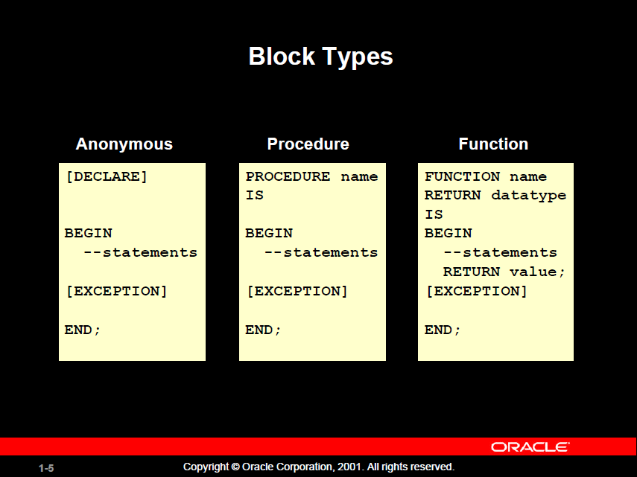

Slide 12
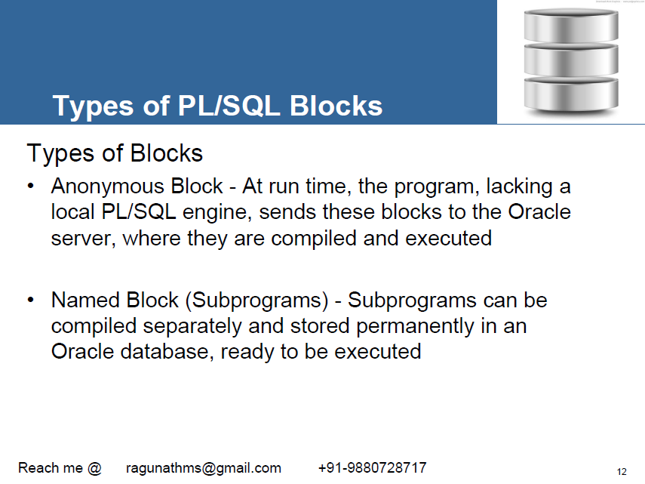

Slide 13
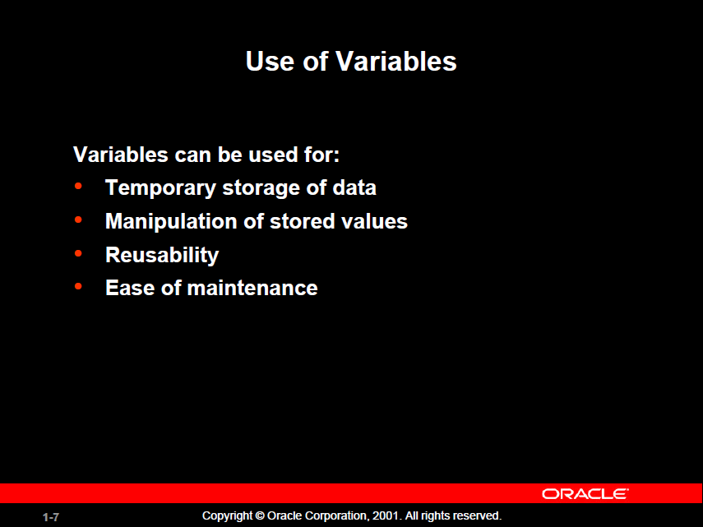

Slide 14
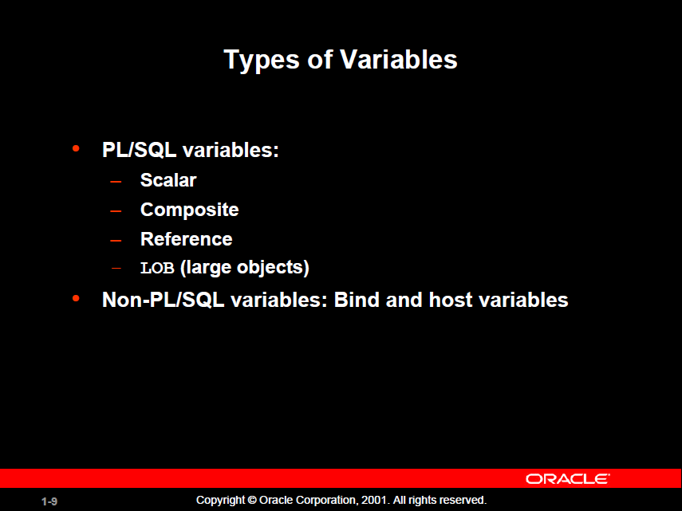

Slide 15
LOB
Used to store large Objects either binary or Character value up to 4 GB in Size.
LOB Manipulated using DBMS_LOB Pacakage
Types of LOBs
BLOB(Binary LOB)- Contain video or picture information
CLOB(Character LOB)- Used to store documents
BFILE(Binary File)-Binary File

Slide 16
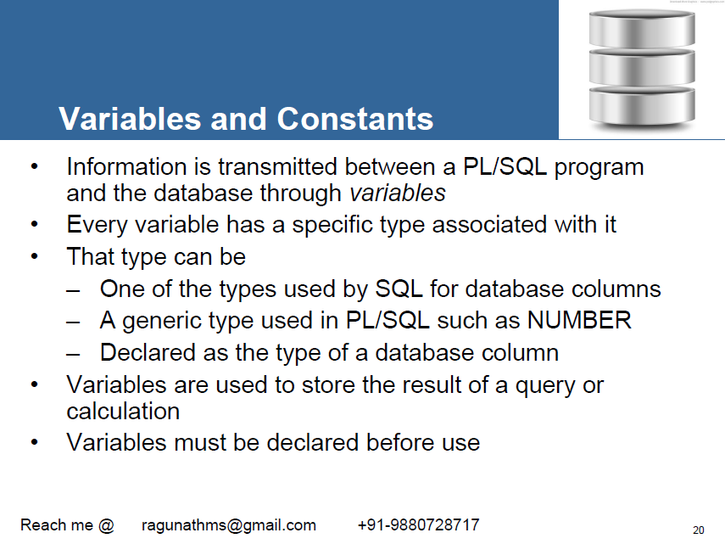

Slide 17
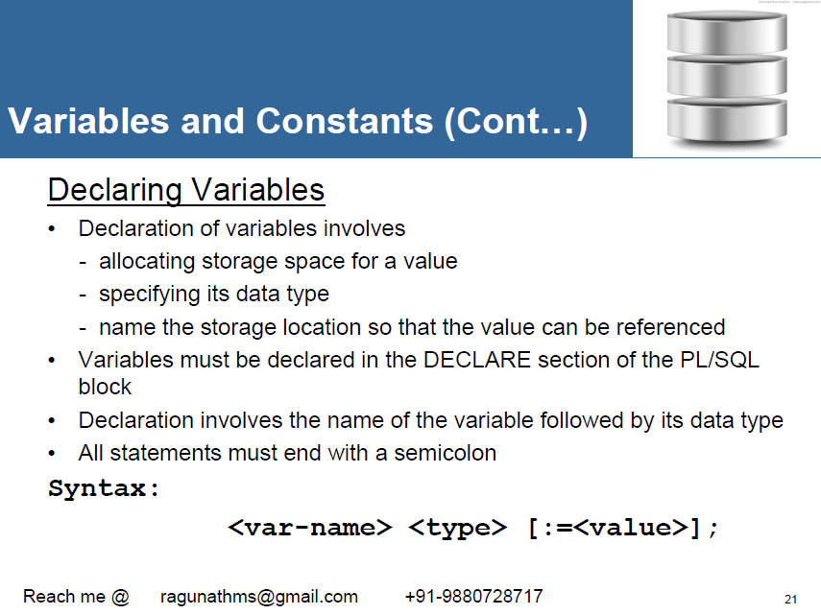

Slide 18
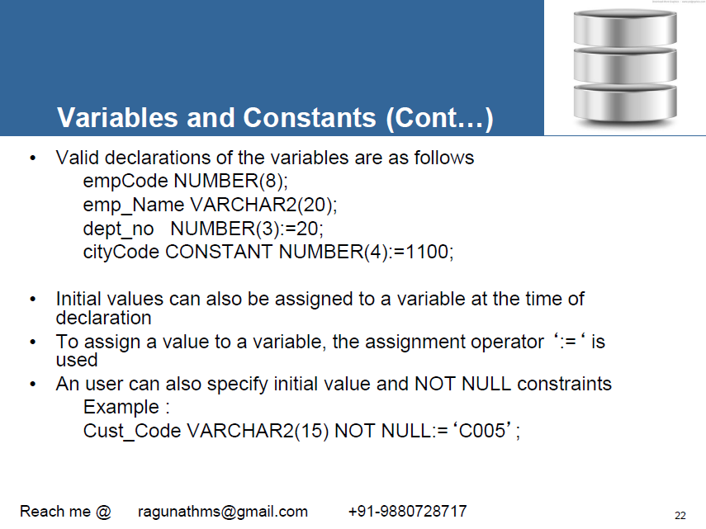

Slide 19
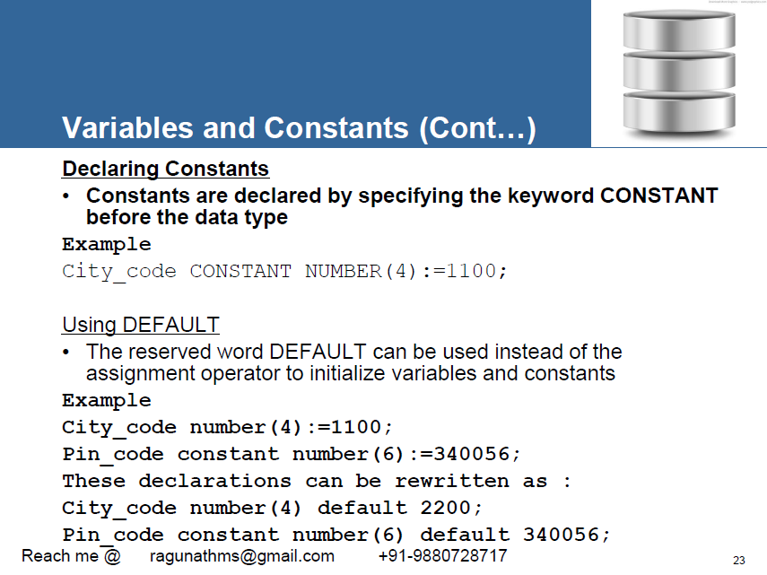

Slide 20
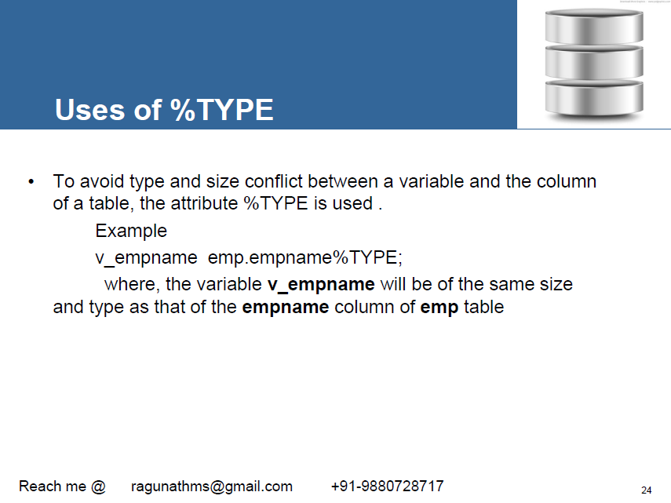

Slide 21
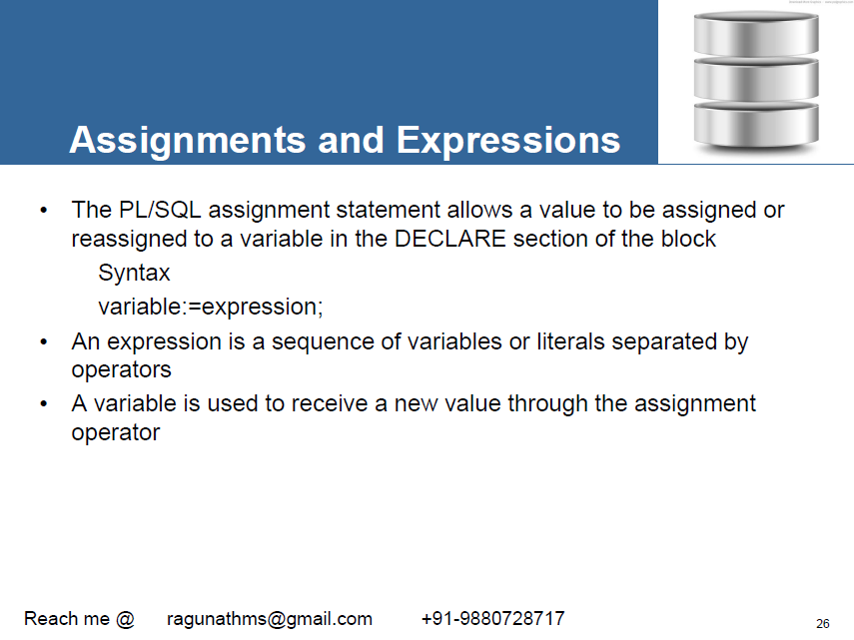

Slide 22
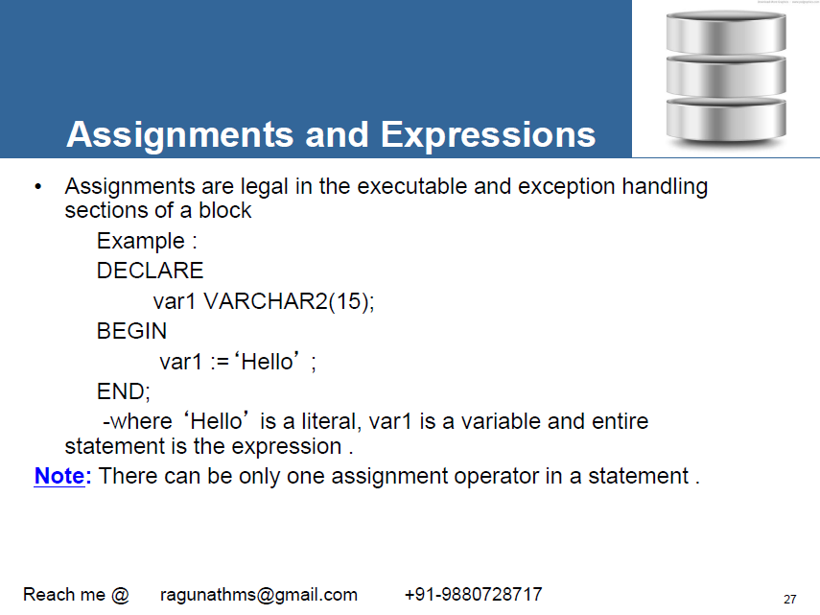

Slide 23
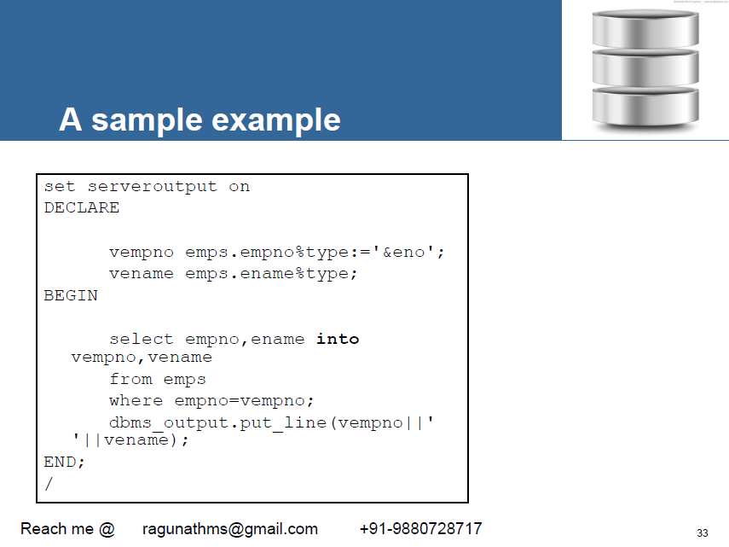

Slide 24
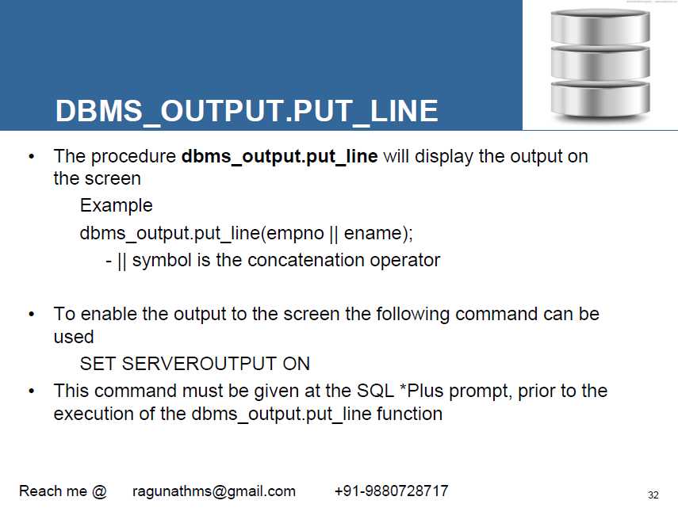

Slide 25
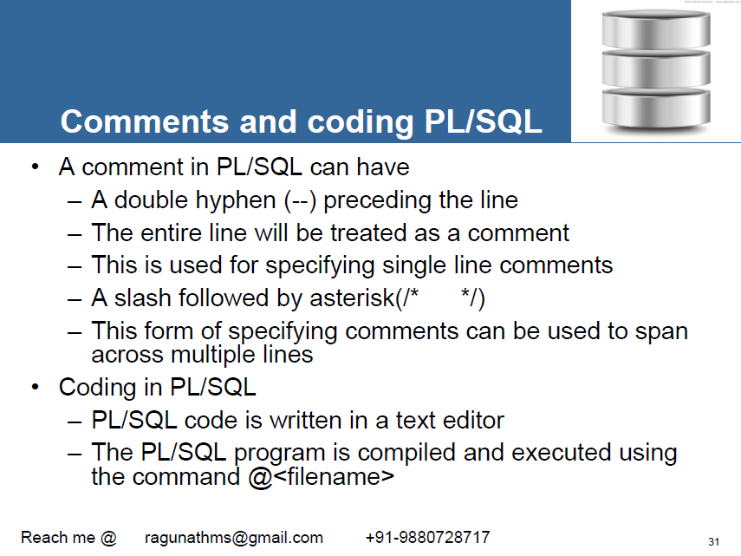

Slide 26
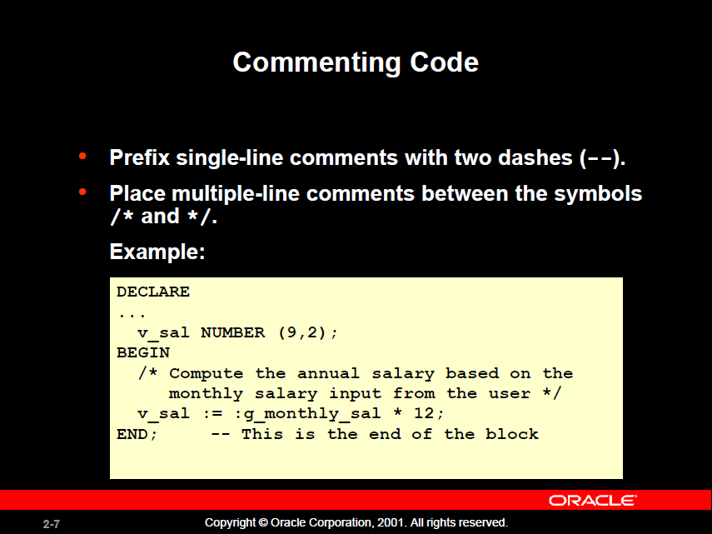

Slide 27
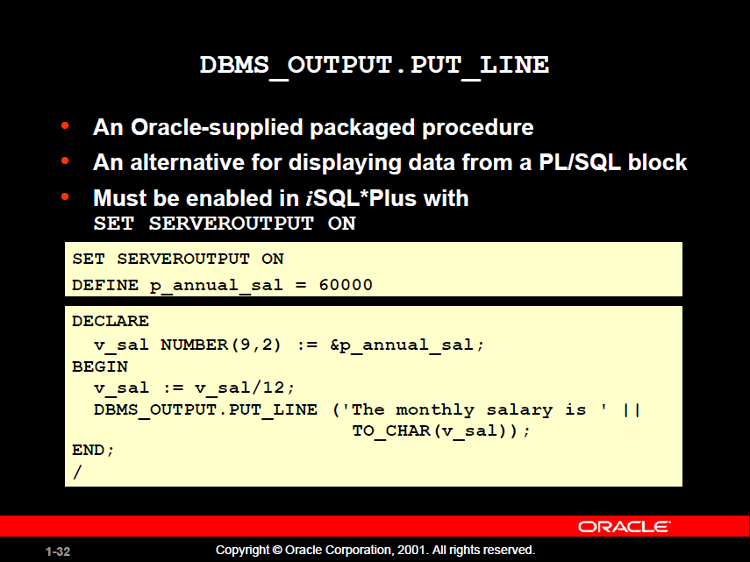

Slide 28
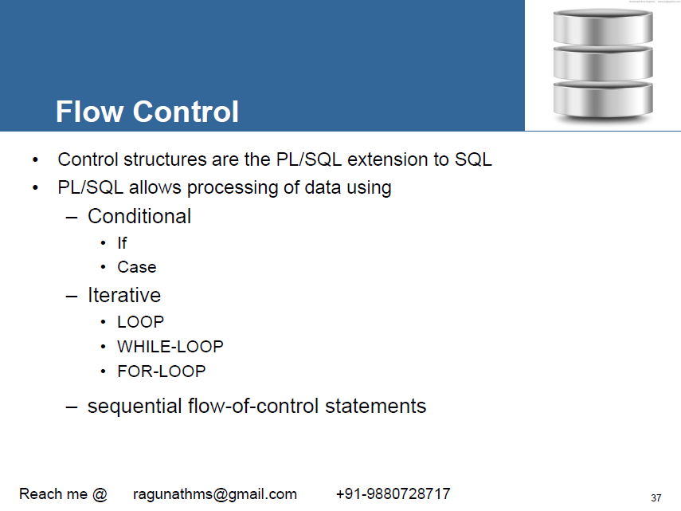

Slide 29
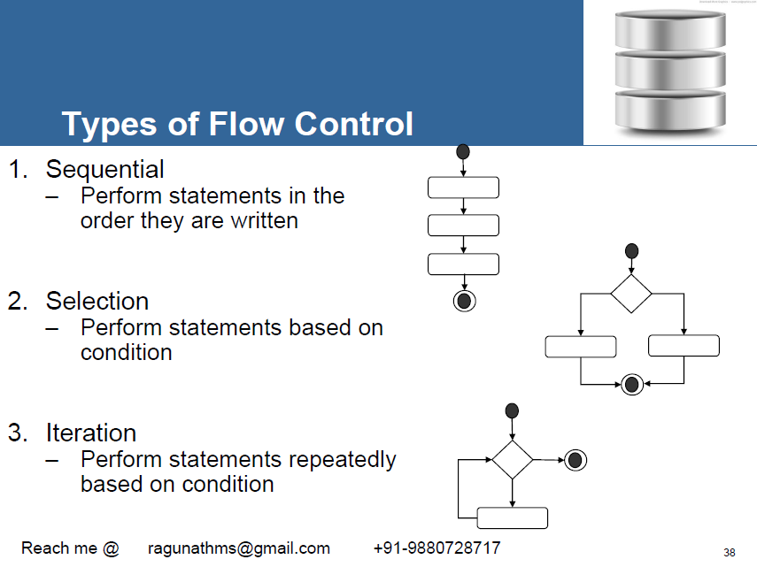

Slide 30
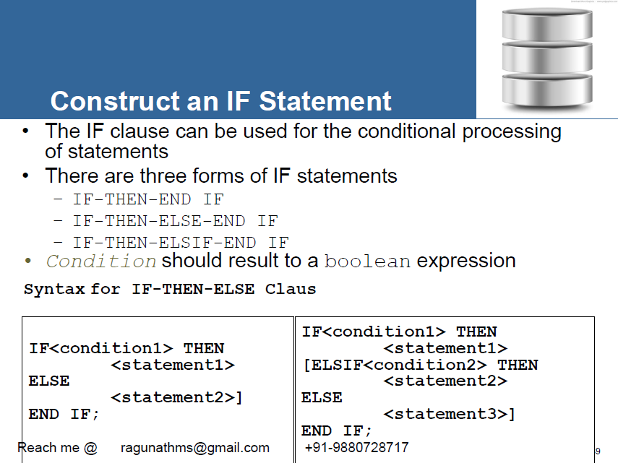

Slide 31
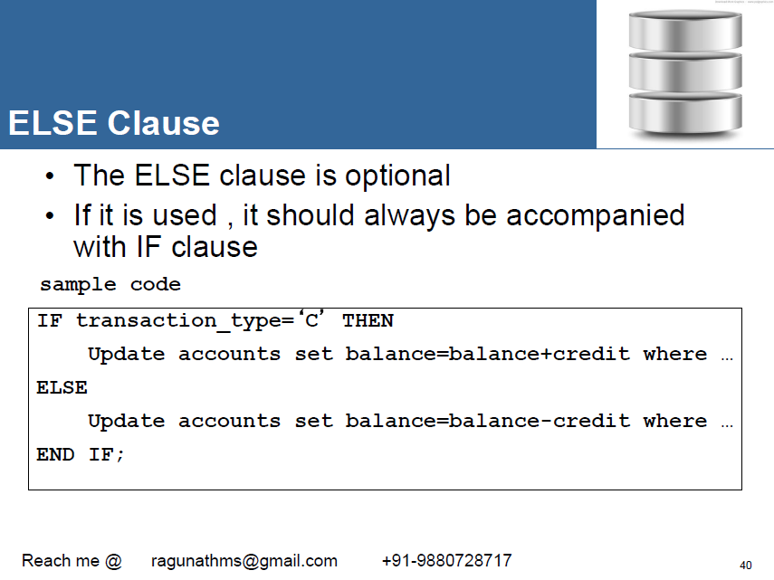
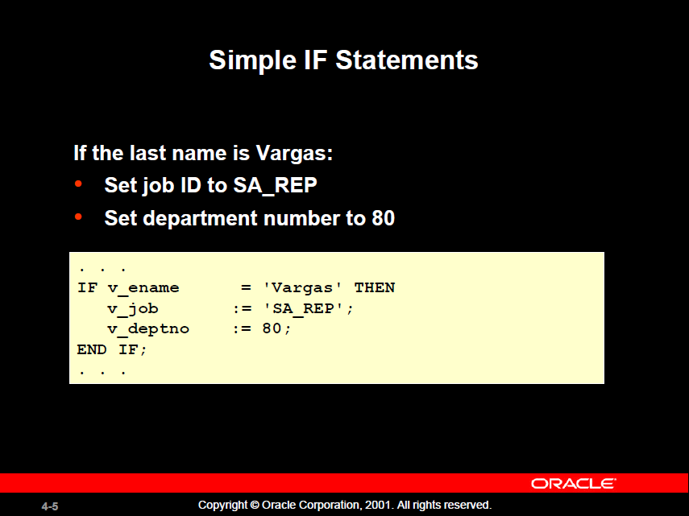

Slide 32
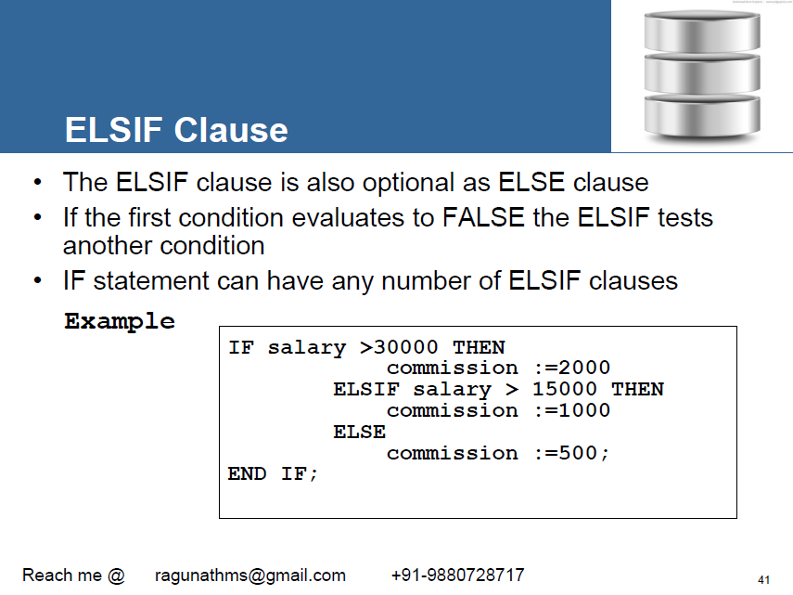
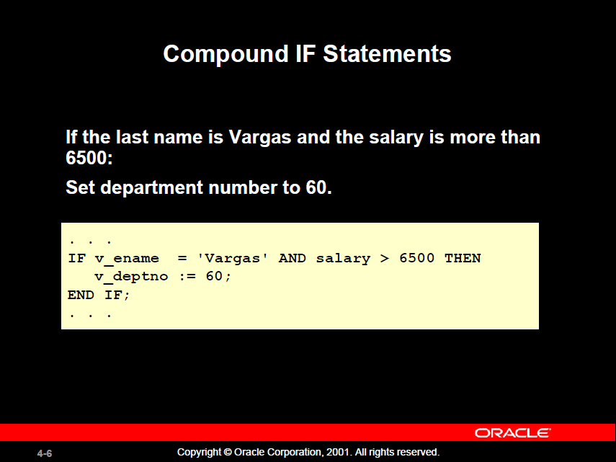

Slide 33
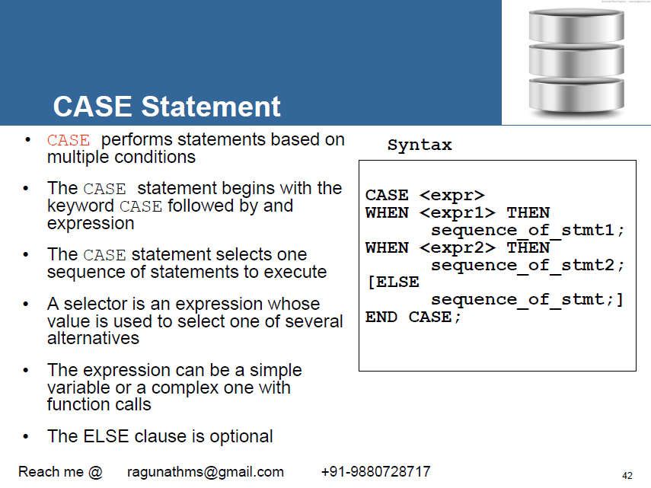
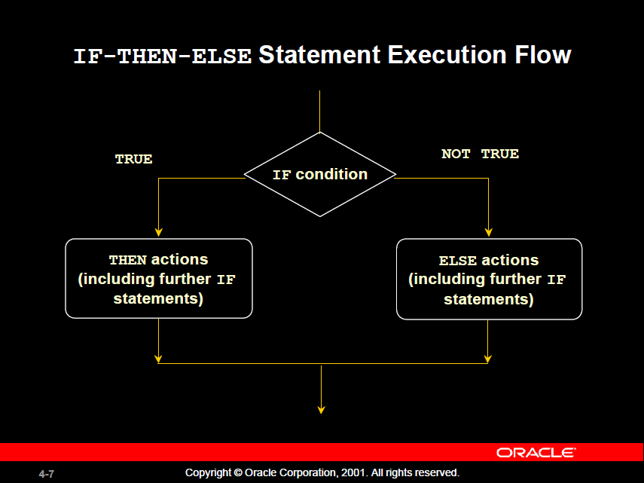

Slide 34
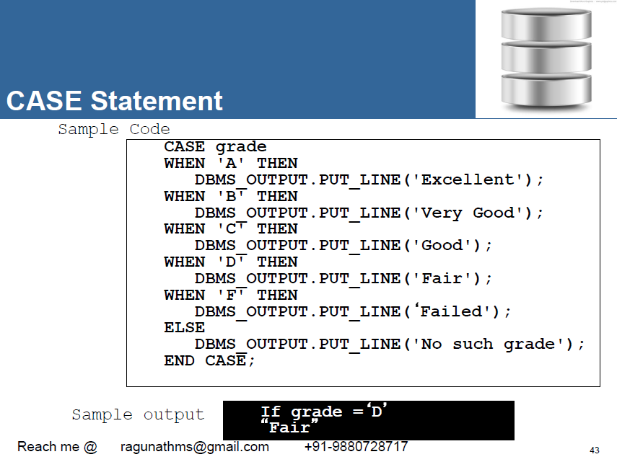
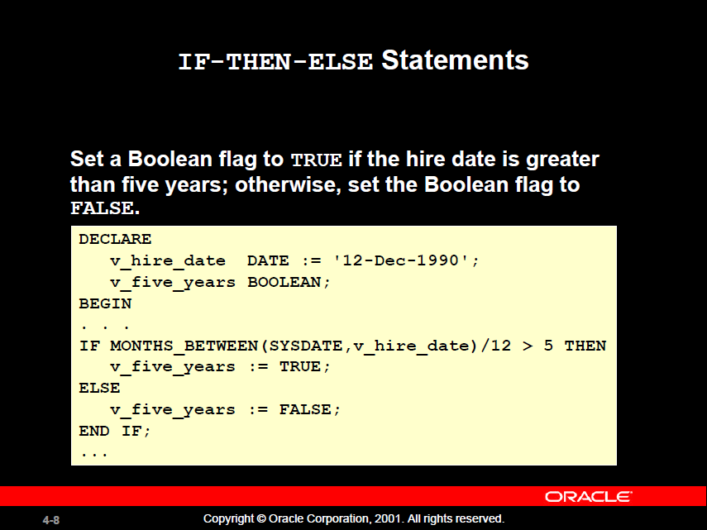

Slide 35
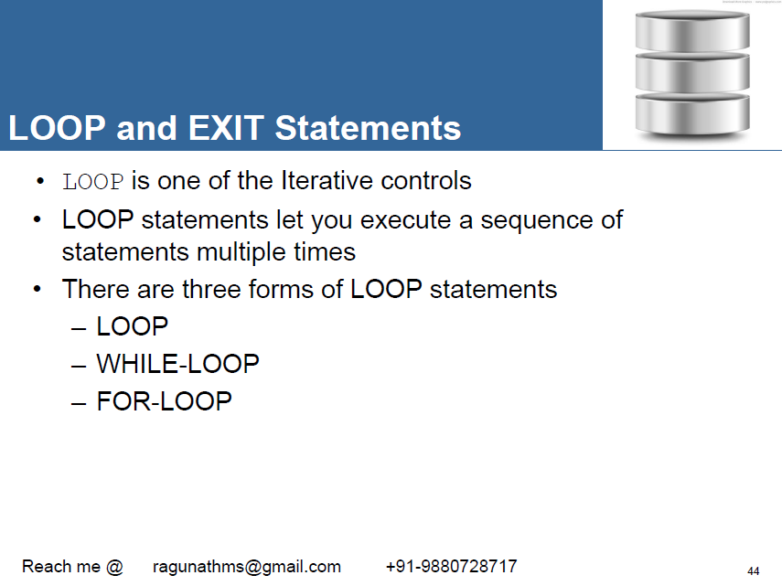
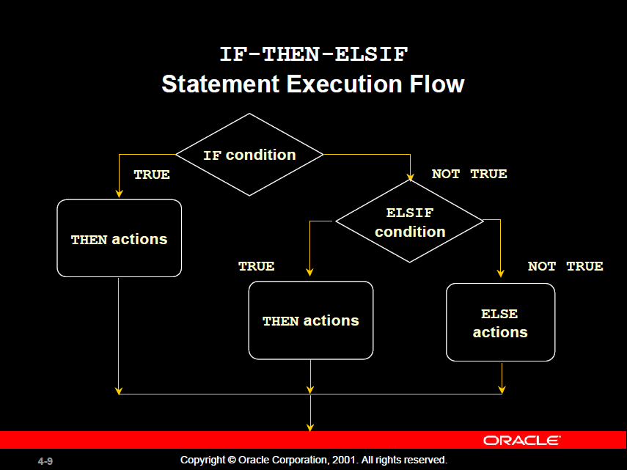

Slide 36
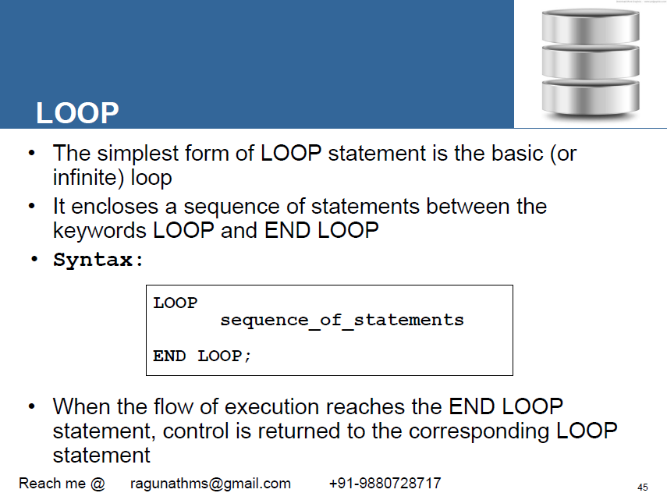
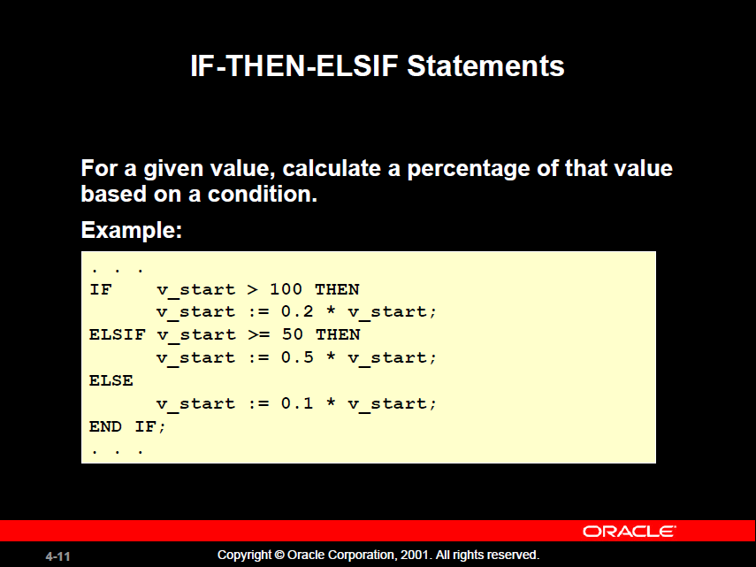

Slide 37
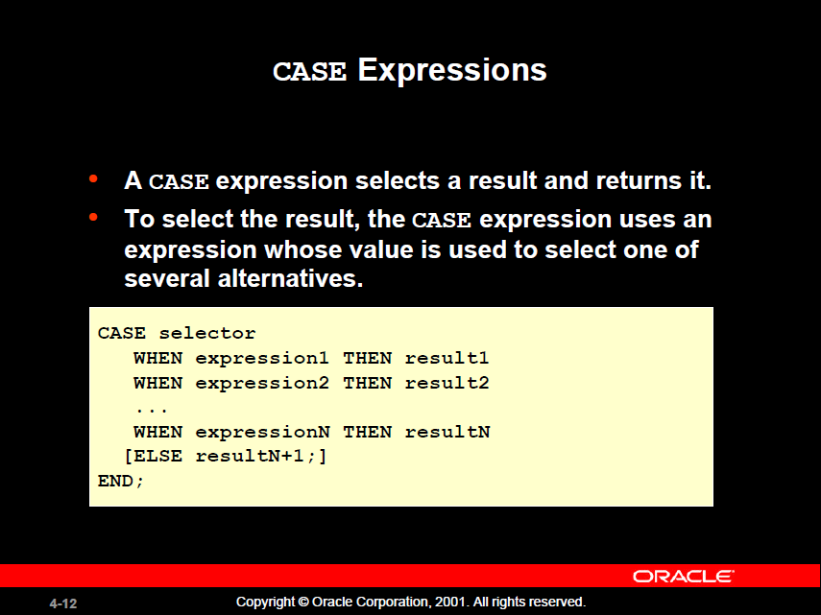
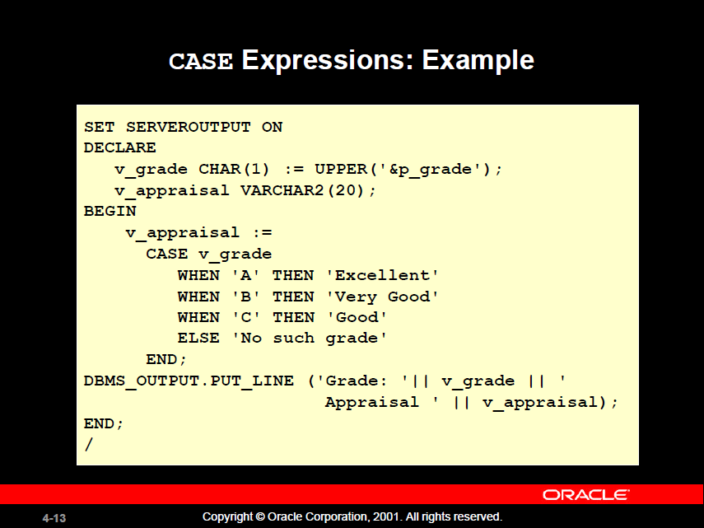

Slide 38
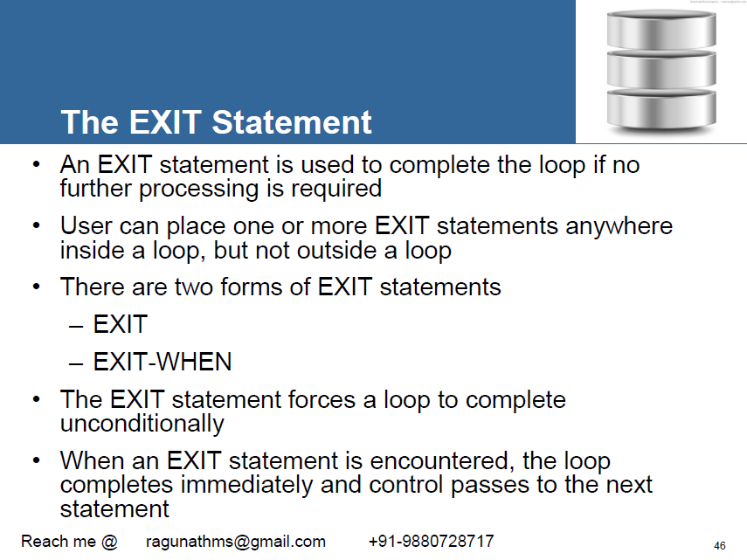

Slide 39
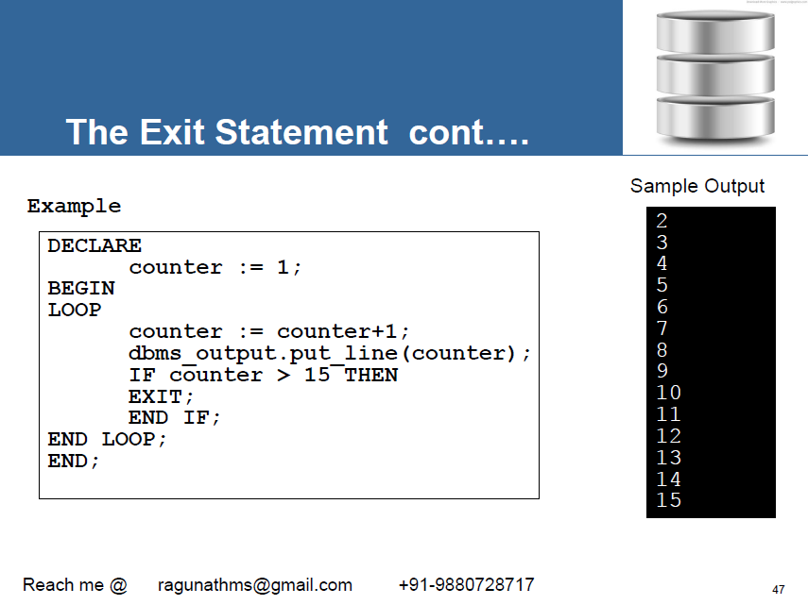

Slide 40
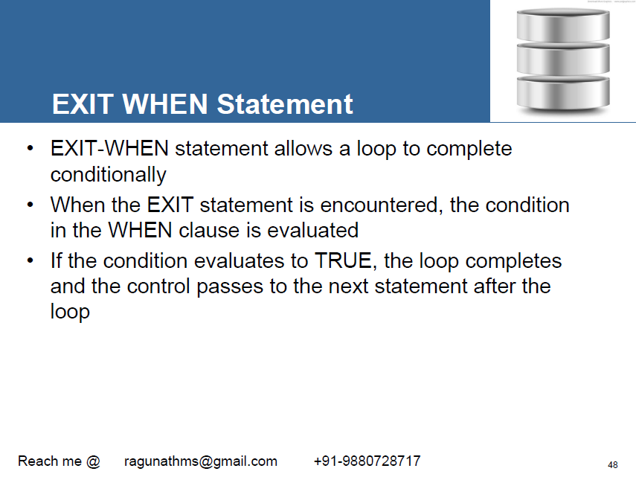

Slide 41
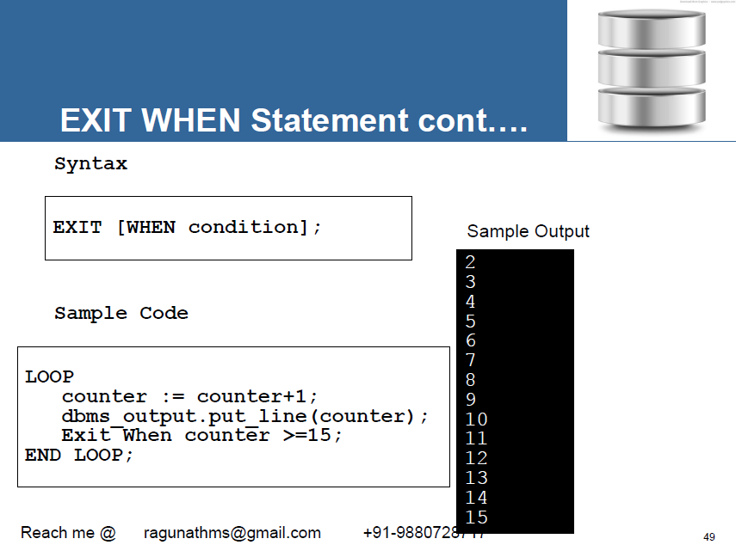

Slide 42
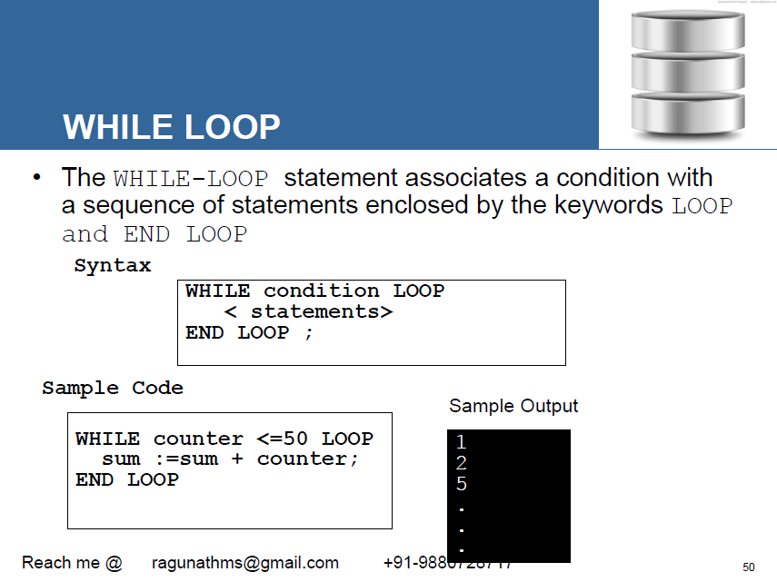

Slide 43
DECLARE a number(2) := 10;
BEGIN
WHILE a < 20
LOOP
dbms_output.put_line('value of a: ' || a);
a := a + 1;
END LOOP;
END;

Slide 44
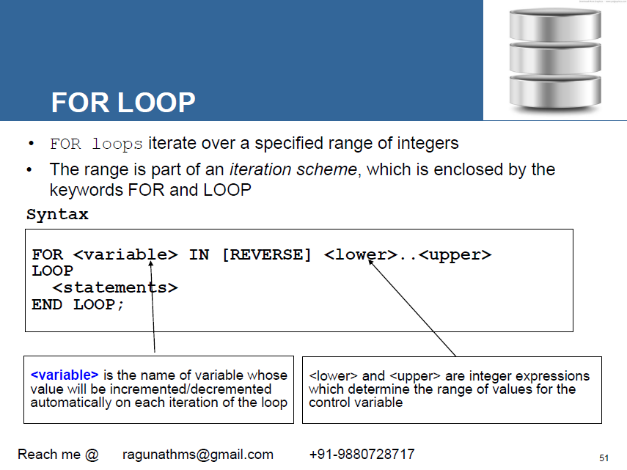

Slide 45
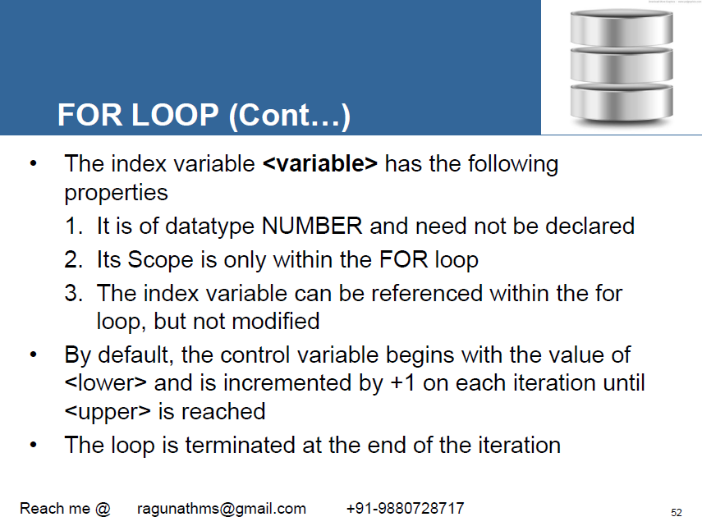

Slide 46
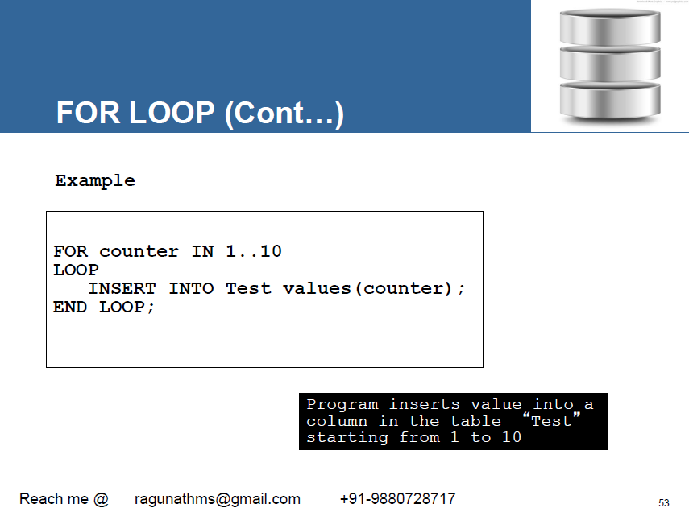

Slide 47
EXAMPLE
DECLARE a number(2);
BEGIN
FOR a in 10 .. 20
LOOP
dbms_output.put_line('value of a: ' || a);
END LOOP;
END;

Slide 48


Slide 49
EXAMPLE
DECLARE a number(2) ;
BEGIN
FOR a IN REVERSE 10 .. 20
LOOP
dbms_output.put_line('value of a: ' || a);
END LOOP;
END; /

Slide 50


Slide 51


Slide 52


Slide 53


Slide 54


Slide 55


Slide 56


Slide 57


Slide 58


Slide 59


Slide 60


Slide 61


